Slide 1
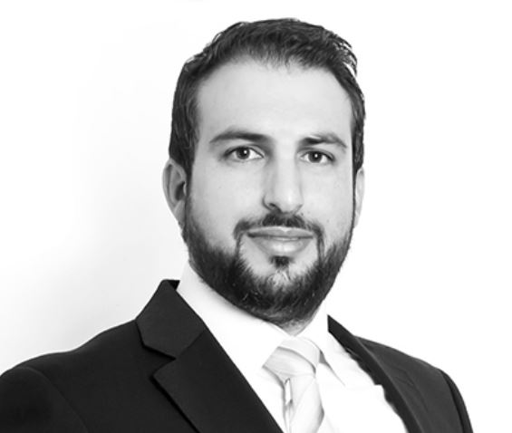
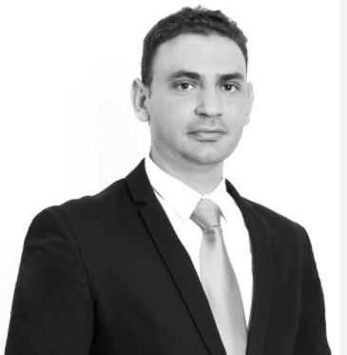
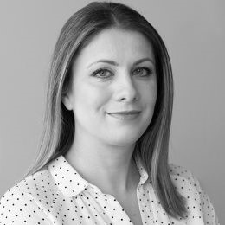
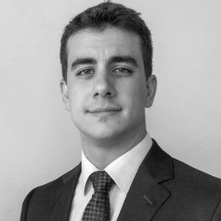
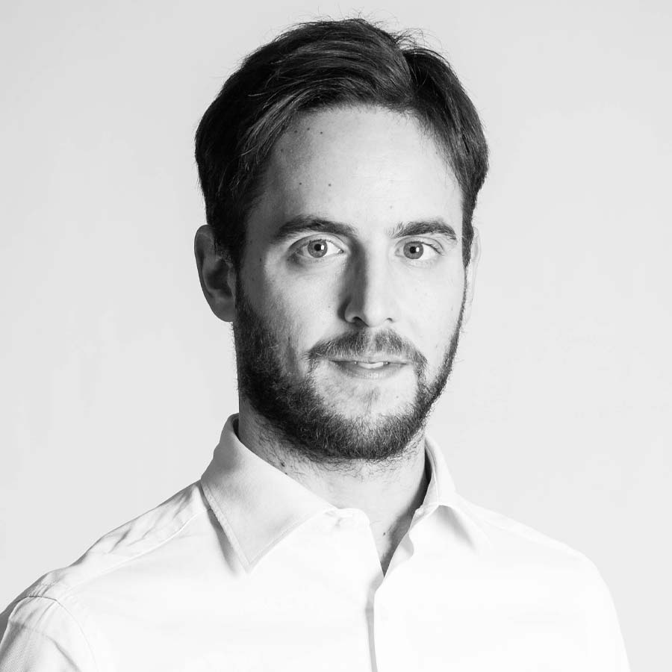
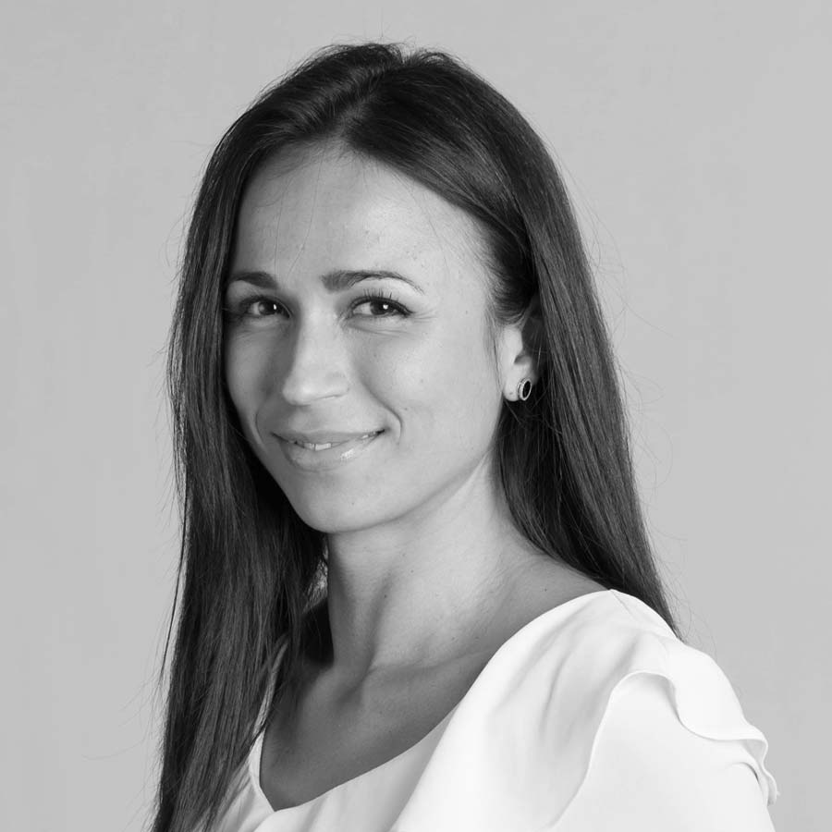
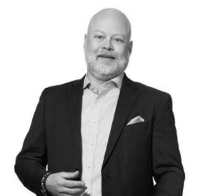
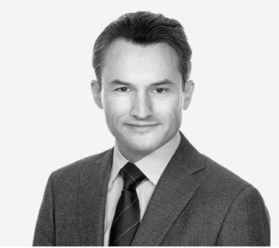
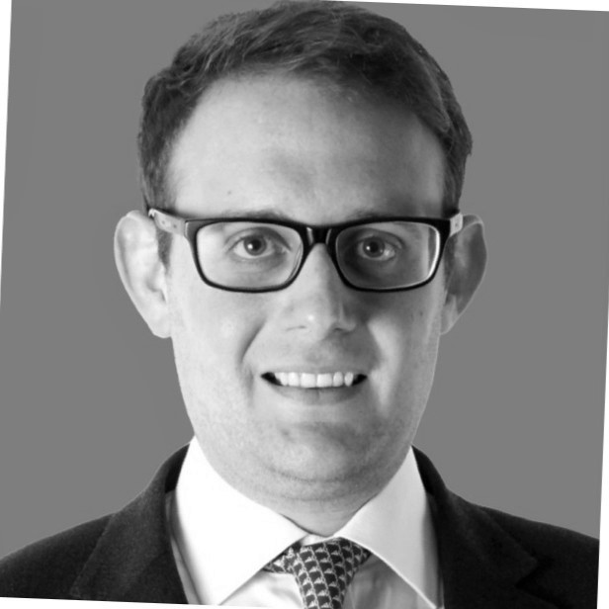
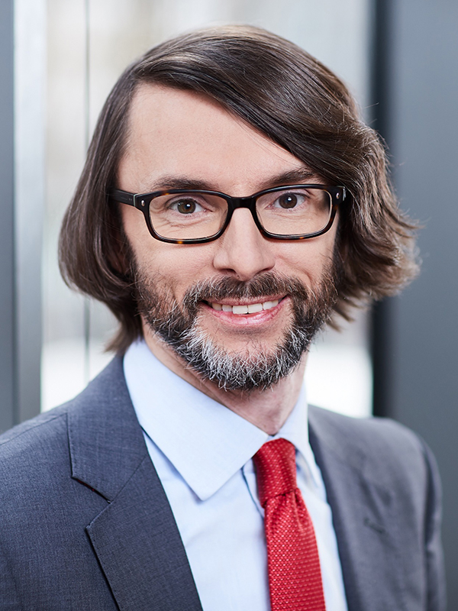
SPEAKERS
Christos A. Theophilou
Costas Savva
Anna Paraskeva
Nikos Maltezos
Luca Galliani
Partner
Partner
Partner
Associate
Manager
Taxand Cyprus
Taxand Cyprus
Zepos & Yannopoulos
Zepos & Yannopoulos
LED Taxand
Cyprus
Cyprus
Greece
Greece
Italy
T: +357 9932 8846
T: +357 9932 8846
T: +30 21 0696 7083
T: +30 210 6967120
T: +39 02 494864
E:ctheophilou@cy.taxand.com
E:csavva@taxand.com.cy
E:a.paraskeva@zeya.com
E: n.maltezos@zeya.com
E: lgalliani@led-taxand.it
Marisana Almeida Dos Santos
Anders Lagerholm
Prof Dr René Matteotti
Jonathan Brecker
Associate
Tax Advisor
Of Counsel
Assistant Director
LED Taxand
Skeppsbron Skatt
Taxpartner
Alvarez & Marsal
Italy
Sweden
Switzerland
UK
T: +39 02 494864
T: +46 4010 7199
T: +41 44 215 77 77
T: +44 207 715 5200
E: madossantos@led-taxand.it
E:anders.lagerholm@skeppsbronskatt.se
E: rene.matteotti@taxpartner.ch
E:jbrecker@alvarezandmarsal.com

