Slide 1
Residence of Private Clients & Global Mobility following the pandemic
PRESENTATION BY
COSTAS SAVVA
ANNA PARASKEVA
NIKOS MALTEZOS
LUCA GALLIANI
MARISANA ALMEIDA DOS SANTOS
RENE MATTEOTTI
JONATHAN BRECKER
CHRISTOS THEOPHILOU
17 JUNE 2021

Slide 2
AGENDA
Introduction
Tax implications from Cyprus, Greece, Italy, Switzerland and UK
Panel Discussion
Questions and Answers
2

Slide 3


BACKGROUND 1: GENERAL OVERVIEW
Mr and Mrs X (the Family) have been resident in State A for their entire life.
Mr and Mrs X are contemplating of relocating to another jurisdiction (Cyprus, Greece, Italy, Switzerland and the UK), for various reasons (e.g. tax, education, climate, business opportunities, and lifestyle).
To minimize their tax risks, Mr and Mrs X would like to plan their wealth accordingly. In doing so, the tax implications are typically threefold.
Taxand: Your global tax partner
@taxand
3
© Copyright 2021 Taxand.

Slide 4
BACKGROUND 2: TAX IMPLICATIONS
Tax implications to consider
From the departing jurisdiction i.e. State A
From the landing jurisdiction (i.e. Cyprus, Greece, Italy, Switzerland and the UK)
Any other jurisdiction that Mr & Mr X have nexus/ties (e.g. spend much of their time, home)
Taxand: Your global tax partner
@taxand
4
© Copyright 2021 Taxand.

Slide 5
BACKGROUND 3: WEALTH OF MR & MRS X
Passive Income
Dividend income
Interest from bank deposits
Active income
Employment income
Stock options
Capital Assets
Immovable Property
Wealth/Inheritance
Rent income from property
Capital Gains
Bonus
Taxand: Your global tax partner
@taxand
© Copyright 2021 Taxand.

Slide 6
BACKGROUND 4: DOMESTIC CRITERIA FOR RESIDENCE
Tax authorities challenge tax residence
Permanent home
Personal and economic relations
(i.e. centre of vital interests)
Occupation, Family and social relations, Political, cultural and other interests.
Physical Presence and Habitual abode
Nationality (i.e. Passport)
Taxand: Your global tax partner
@taxand
© Copyright 2021 Taxand.

Slide 7
CYPRUS
COSTAS SAVVA
TAXAND CYPRUS

Slide 8

TAXABLE INDIVIDUALS: 2 CRITERIA
For a period or periods exceeding in aggregate 183 days in the tax year.
OR
2) Provided the individual satisfies all of the following conditions within the same tax year:
she/he is not a tax resident of any other country;
she/he spends at least 60 days in Cyprus;
she/he maintains a permanent home in Cyprus that is either owned or rented;
she/he carries on a business in Cyprus, is employed in Cyprus or holds an office in a Cyprus tax resident company.
Taxand: Your global tax partner
@taxand
8
© Copyright 2021 Taxand.

Slide 9
TAXABLE INCOME
Taxable income: Resident individuals are subject to income tax on their worldwide income. Rates: 0% to 35% (Above EUR 60,000).
Special tax regime Expatriate individuals
Non-domicile individuals are not subject tax on passive income (i.e. Dividends, Interest) received.
20% of the annual remuneration from an office or employment exercised in Cyprus or EUR 8,550 (whichever is lower) is exempt from income tax; or
50% exemption applies to income of a non-resident individual, who takes up a residence in Cyprus to work for an employer in Cyprus provided that the annual income of the employee exceeds EUR 100,000 per annum.
Taxand: Your global tax partner
@taxand
9
© Copyright 2021 Taxand.

Slide 10
EXEMPT INCOME
Profits from the sale of securities, including shares in companies and units in mutual funds;
Income from a buy-back or redemption of units in mutual funds;
Foreign exchange (FX) gains with the exception of FX gains arising from the trade in foreign currencies; and
Remuneration from salaried services rendered by a resident individual outside Cyprus on behalf of a non-resident employer or a permanent establishment located outside Cyprus of a resident employer for at least 90 days in total in the tax year is exempt from income tax.
Taxand: Your global tax partner
@taxand
10
© Copyright 2021 Taxand.

Slide 11
OTHER TAXES ON INCOME & CAPITAL
No net wealth tax, Inheritance and Gift Tax.
No Real estate tax (similarly Immovable property located abroad is not subject to real estate tax in Cyprus).
Capital gains on immovable property located abroad are not subject to capital gains tax.
No special rules apply to outward expatriates (e.g. exit tax, extended source taxation, deemed residence rules upon emigration).
Taxand: Your global tax partner
@taxand
11
© Copyright 2021 Taxand.

Slide 12
GREECE
ANNA PARASKEVA
NIKOS MALTEZOS
ZEPOS & YANNOPOULOS

Slide 13

GENERAL OVERVIEW
A married couple has been residing outside Greece* for its entire life.
The married couple is contemplating of relocating to Greece.
To minimize its tax risks, the married couple would like to plan its wealth accordingly. In doing so, the tax implications and conditions for obtaining Greek tax residence shall be considered.
* The married couple is assumed to have been residing in a cooperative tax jurisdiction
Taxand: Your global tax partner
@taxand
13
© Copyright 2021 Taxand.

Slide 14

GREEK TAX RESIDENCE CONDITIONS
Permanent or main home or habitual abode or center of vital interests in Greece
[personal and economic relations]
Presence in Greece exceeding the 183 days threshold
or
Indicative list of vital interests:
Residence of family members
Employment
Property interests
Administrative relations with public authorities (social insurance, professional)
Taxand: Your global tax partner
@taxand
14
© Copyright 2021 Taxand.

Slide 15

GREEK SPECIAL TAX RESIDENCE REGIMES
HNWI Tax Regime
Tax incentives
EUR 100,000 lump sum tax on foreign source income (plus EUR 20,000 per close relative)
No justification required for funds imported in Greece
Foreign-source income not reportable in annual income tax return
Donation/inheritance tax exemption for assets located outside Greece
Conditions
Tax residence outside Greece for 7 out of 8 preceding years
Investment in Greek assets (real estate, shares or other securities) > EUR 500,000 within 3 years following qualification (administrative guidance pending)
Duration
Up to 15 years
Taxand: Your global tax partner
@taxand
15
© Copyright 2021 Taxand.

Slide 16
GREEK SPECIAL TAX RESIDENCE REGIMES
Retiree Tax Regime
Tax incentives
7% flat tax on foreign source income including pensions
Exemption from special solidarity contribution
Conditions
Revenue from foreign source pension (“qualifying pensions”)
Tax residence outside Greece for 5 out of the last 6 years
State of origin excludes non-cooperative tax jurisdictions
Duration
Up to 15 years
Taxand: Your global tax partner
@taxand
16
© Copyright 2021 Taxand.

Slide 17
GREEK SPECIAL TAX RESIDENCE REGIMES
Executives Tax Regime
Tax incentives
50% tax break on Greek source salary/business income
Exemption from deemed income rules for main residence & car
Conditions
Tax residence outside Greece for 5 out of the last 6 years
Residence in an EU/EEA country or in a tax cooperative jurisdiction
Hired by a Greek employer (or exercising business activity in Greece)
2 year minimum stay in Greece
Duration
Up to 7 years
Taxand: Your global tax partner
@taxand
17
© Copyright 2021 Taxand.

Slide 18
PASSIVE INCOME
Passive income | Ordinary tax regime |  | HNWI tax regime |  | Retiree tax regime |  | Executives tax regime
 | Greek source | Foreign source* | Greek source | Foreign source | Greek source | Foreign source* | Greek source | Foreign source*
Dividend | 5% (plus SSC** up to 10%) |  | 5% (plus SSC up to 10%) | Euro 100.000 (plus Euro 20.000 per relative) | 5% (plus SSC up to 10%) | 7% | 5% (plus SSC up to 10%)
Interest from bank deposit | 15% (plus SSC up to 10%) |  | 15% (plus SSC up to 10%) |  | 15% (plus SSC up to 10%) |  | 15% (plus SSC up to 10%)
Rental income from property | 15%-45% (plus SSC up to 10%) |  | 15%-45% (plus SSC up to 10%) |  | 15%-45% (plus SSC up to 10%) |  | 15%-45% (plus SSC up to 10%)
Capital gains | 15% from sale of securities (plus SSC up to 10%) N/A for sale of real estate property |  | 15% from sale of securities (plus SSC up to 10%) N/A for sale of real estate property |  | 15% from sale of securities (plus SSC up to 10%) N/A for sale of real estate property |  | 15% from sale of securities (plus SSC up to 10%) N/A for sale of real estate property
*Subject to the applicable Double Tax Conventions
** SSC (Special Solidarity Contribution) mentioned hereinabove is not applicable for years 2020 and 2021
Taxand: Your global tax partner
@taxand
18
© Copyright 2021 Taxand.

Slide 19
ACTIVE INCOME
Active income | Ordinary tax regime |  | HNWI tax regime |  | Retiree tax regime |  | Executives tax regime
 | Greek source | Foreign source* | Greek source | Foreign source | Greek source | Foreign source* | Greek source | Foreign source*
Employment | 9%-44% (plus SSC** up to 10%) |  | 9%-44% (plus SSC up to 10%) | Euro 100.000 (plus Euro 20.000 per relative) | 9%-44% (plus SSC up to 10%) | 7% | Income tax and SSC levied only on 50% of employment income | 9%-44% (plus SSC up to 10%)
Stock options | 9%-44% (plus SSC up to 10%) for shares not being sold within 24 months (or 36 months for start-ups) 15% (plus SSC up to 10%) for shares not being sold after 24 months (or 36 months for start-ups) |  | 9%-44% (plus SSC up to 10%) for shares not being sold within 24 months (or 36 months for start-ups) 15% (plus SSC up to 10%) for shares not being sold after 24 months (or 36 months for start-ups) |  | 9%-44% (plus SSC up to 10%) for shares not being sold within 24 months (or 36 months for start-ups) 15% (plus SSC up to 10%) for shares not being sold after 24 months (or 36 months for start-ups) |  |  | 9%-44% (plus SSC up to 10%) for shares not being sold within 24 months (or 36 months for start-ups) 15% (plus SSC up to 10%) for shares not being sold after 24 months (or 36 months for start-ups)
Bonus | 9%-44% (plus SSC up to 10%) |  | 9%-44% (plus SSC up to 10%) |  | 9%-44% (plus SSC up to 10%) |  |  | 9%-44% (plus SSC up to 10%)
*Subject to the applicable Double Tax Conventions
** SSC on employment income (incl. shares not being sold within 24 or 36 months and bonus) s not applicable for years 2021 and 2022
Taxand: Your global tax partner
@taxand
19
© Copyright 2021 Taxand.

Slide 20
CAPITAL ASSETS
Capital assets | Ordinary tax regime |  | HNWI tax regime |  | Retiree tax regime |  | Executives tax regime
 | Greek situs | Foreign situs | Greek situs | Foreign situs | Greek situs | Foreign situs | Greek situs | Foreign situs
Immovable property | Unified Real Estate Property tax due ranges from Euro 0.001 to Euro 13 per sq.m., readjusted by a number of coefficients (e.g. based on floor, age, façade etc.) | N/A | Unified Real Estate Property tax due ranges from Euro 0.001 to Euro 13 per sq.m., readjusted by a number of coefficients (e.g. based on floor, age, façade etc.) | N/A | Unified Real Estate Property tax due ranges from Euro 0.001 to Euro 13 per sq.m., readjusted by a number of coefficients (e.g. based on floor, age, façade etc.) | N/A | Unified Real Estate Property tax due ranges from Euro 0.001 to Euro 13 per sq.m., readjusted by a number of coefficients (e.g. based on floor, age, façade etc.) | N/A
Financial Assets | N/A |  | N/A |  | N/A |  | N/A
Inheritance | Up to 10%, 20% and 40% depending on kinship of deceased and heir | Up to 10%, 20% and 40% for movable assets N/A for real estate property | Up to 10%, 20% and 40% depending on kinship of deceased and heir | Euro 100.000 (plus Euro 20.000 per relative) for movable assets inherited N/A for real estate property | Up to 10%, 20% and 40% depending on kinship of deceased and heir | Up to 10%, 20% and 40% for movable assets N/A for real estate property | Up to 10%, 20% and 40% depending on kinship of deceased and heir | Up to 10%, 20% and 40% for movable assets N/A for real estate property
Taxand: Your global tax partner
@taxand
20
© Copyright 2021 Taxand.

Slide 21
ITALY
MARISANA ALMEIDA
DOS SANTOS
LED TAXAND

Slide 22

DOMESTIC CRITERIA FOR RESIDENCE
At least one of the below conditions must be met in Italy for more than 183 days in a calendar year
Registration in the register of resident population
Domicile
(i.e. centre of personal and economic
interests)
Occupation, family and social relations, political, cultural and other interests.
Habitual abode
Taxand: Your global tax partner
@taxand
22
© Copyright 2021 Taxand.

Slide 23
ITALIAN FAVOURABLE REGIMES
HIGH NET WORTH REGIME
ADVANTAGES:
€100k (or €25k for each family member) flat tax for foreign income, that substitutes any other Italian tax
Inheritance and gift tax exemption
Tax monitoring obligations exemption
Wealth tax exemption
Possibility to cherry-pick countries and assets to be excluded from this regime and to be included in the Italian tax return instead (these items will be subject to the ordinary taxation)
CFC rules do not apply
DURATION:
It lasts for a maximum of 15 years (it can be interrupted earlier)
It ends immediately in case the flat tax is not entirely/partly paid by the deadline
WHO CAN OPT:
natural persons (Italian citizens or not)
that have not been resident in Italy for tax purposes for 9 out of 10 of the previous calendar years (or have never been resident in Italy)
that transfer the residence for tax purposes in Italy
The regime can be extended to some or all family members that satisfy the mentioned requirements. In this case, an additional flat tax of €25k is due for each additional member.
HOW TO OPT:
in the tax return to the tax period in which the person transferred his tax residence to Italy;
relating to the following tax period.
An advance ruling can be filed to the Italian Tax Authorities in order to obtain a confirmation about the application of the regime to the specific case.
Taxand: Your global tax partner
@taxand
23
© Copyright 2021 Taxand.

Slide 24
ITALIAN FAVOURABLE REGIMES
INPATRIATES REGIME
ADVANTAGES:
Italian source employment and self-employment income are subject to Individual Income Tax (“IIT”) only on 30% of their amount (10% in case the worker moves his/her residence to one of the Southern Italian regions)
DURATION:
It is granted for a period of 5 years starting from the year when the worker moves his/her tax residence to Italy
It is granted for additional 5 years (and the Italian source employment and self-employment income are subject to IIT only on 50%) if the worker:
has a child under the age of 18 or
purchases a residential property in Italy following the transfer of his residence to Italy or during the 12 months preceding the transfer
if there are at least 3 children, the exemption increase up to 90%
WHO CAN OPT:
natural persons (Italian citizens or not) that transfer the residence for tax purposes in Italy and:
Option 1: (i) have not been resident in Italy for tax purposes for the two fiscal years preceding the transfer to Italy, (ii) remain tax resident in Italy for at least 2 years and (iii) mainly perform their working activity in Italy (at least 183 days in year); or
Option 2: (i) have continuously worked for at least 24 months abroad and have a University educational title (or they studied abroad for more than 24 months, and they got a University title).
HOW TO OPT:
Employment income: the option can be made either i) directly in the annual tax return or ii) by filing a written request to the employer that, consequently, will apply the WHT on the reduced taxable income.
Self-employment income: the option can be made either i) directly in the annual tax return or ii) by filing a written request to the customers that, consequently, will apply the WHT on the reduced taxable income.
Taxand: Your global tax partner
@taxand
24
© Copyright 2021 Taxand.

Slide 25
PASSIVE INCOME
Passive income | Ordinary regime |  | High net worth regime |  | Inpatriates regime
 | Italian source | Foreign source | Italian source | Foreign source | Italian source | Foreign source
Dividend | 26% | 26% (except from blacklist countries). | ordinary regime | Lump-sum taxation | ordinary regime | ordinary regime
Interest from bank deposit | 26% | 26% | ordinary regime | Lump-sum taxation | ordinary regime | ordinary regime
Rental income from property | Progressive tax rate from 23% to 43% ("PTR") or by option substitute tax from 10% to 21% of the rent | 1) if taxed abroad: PTR + FTC; 2) If not taxed abroad: PTR on the rental income less 15% lump sum deduction; no FTC | ordinary regime | Lump-sum taxation | ordinary regime | ordinary regime
Capital gains | 26% | 26% (except from blacklist countries). | ordinary regime | Lump-sum taxation excluding capital gains from the sale of foreign qualified participations in the first 5 years (WHT 26%) | ordinary regime | ordinary regime
Taxand: Your global tax partner
@taxand
25
© Copyright 2021 Taxand.

Slide 26
ACTIVE INCOME
Active income | Ordinary regime |  | High net worth regime |  | Inpatriates regime
 | Italian source | Foreign source | Italian source | Foreign source | Italian source | Foreign source
Employment | PTR | PTR + FTC | ordinary regime | Lump-sum taxation | exemption of the 70%/90% of the taxable income in the first 5 years. 50%/90% in the following 5 years | ordinary regime
Stock options | PTR on the difference between the FMV of the shares at exercise date and the exercise price paid by the employee | PTR + FTC | ordinary regime | Lump-sum taxation | exemption of the 70%/90% of the taxable income in the first 5 years. 50%/90% in the following 5 years | ordinary regime
Bonus | PTR | PTR + FTC | ordinary regime | Lump-sum taxation | exemption of the 70%/90% of the taxable income in the first 5 years. 50%/90% in the following 5 years | ordinary regime
Taxand: Your global tax partner
@taxand
26
© Copyright 2021 Taxand.

Slide 27
CAPITAL ASSETS
Capital assets | Ordinary regime |  | High net worth regime |  | Inpatriates regime
 | Italian source | Foreign source | Italian source | Foreign source | Italian source | Foreign source
Immovable property | IMU at a rate of 0,86% on the revaluated cadastral value of the asset (some exceptions apply) | 1) IVIE at 0,76% rate on the purchase cost or FMV of the assets; 2) reporting obligations | ordinary regime | exemption from IVIE and reporting obligations | ordinary regime | ordinary regime
Financial Assets | stamp duty | 1) IVAFE at 0,2% on the FMV or nominal value (€34,2 for bank accounts and similar); 2) reporting obligations | ordinary regime | exemption from IVIE and reporting obligations | ordinary regime | ordinary regime
Inheritance | From 4% to 8% with certain thresholds in case the beneficiaries are relatives | From 4% to 8% with certain thresholds in case the beneficiaries are relatives | ordinary regime | exemption on foreign assets | ordinary regime | ordinary regime
Taxand: Your global tax partner
@taxand
27
© Copyright 2021 Taxand.

Slide 28
SWITZERLAND
RENÉ MATTEOTTI
TAXPARTNER

Slide 29

DOMESTIC CRITERIA FOR RESIDENCE
Physical presence in Switzerland is required and at least one of the below conditions must be met
Intention to permanently establish an habitual abode (i.e. centre of vital interest) and registration with the municipal authorities
Exercise of a gainful activity for a consecutive period of at least 30 days (regardless of temporary interruptions)
Stay without gainful activity for a consecutive period of at least 90 days (regardless of temporary interruptions)
Taxand: Your global tax partner
@taxand
29
© Copyright 2021 Taxand.

Slide 30
SWISS FAVOURABLE REGIMES
LUMP-SUM TAXATION
ADVANTAGES:
Taxes are levied on a deemed income (the “lump sum”) that derives from the annual cost of living.
No taxation on effective worldwide income and wealth. As a result, the effective tax burden can be extremely attractive compared to ordinary taxation.
Simple mode of taxation (no complex tax declaration).
TO CONSIDER:
Due to the federalist tax system in Switzerland, the rules of taxation can vary by Canton.
The lump-sum tax regime has been abolished in the following Cantons: Appenzell Outer-Rhodes, Basel-City, Basel-Country*, Schaffhausen* and Zurich.
TAX CALCULATION:
The taxable income is determined on the basis of the total annual cost of living or a multiple (7x) of the annual rental costs of the taxpayer and his dependents.
For federal tax purposes the minimum taxable income is at least CHF 400’000. For cantonal/communal tax purposes the minimum tax base may be lower in some instances.
The taxable wealth is usually calculated by multiplying the taxable income with the factor 20.
CONTROL CALCULATION:
The taxable income based on the annual cost of living has to be at least as high as the sum of the individual’s Swiss-sourced income. For this purpose, a parallel “control calculation” must be established.
If the income under the control calculation is higher than the lump sum determined based on the annual cost of living, the former will be the basis for the income tax.
*Lump-sum taxation still possible in the first year of arrival in Switzerland
Taxand: Your global tax partner
@taxand
30
© Copyright 2021 Taxand.

Slide 31
SWISS FAVOURABLE REGIMES
LUMP-SUM TAXATION
DURATION:
It ends when a person acquires Swiss citizenship or takes up a gainful activity in Switzerland.
It can be switched to the ordinary regime at any time, however, the reverse is not possible.
WHO CAN OPT:
Non-Swiss nationals,
who do not pursue a gainful activity in Switzerland, and
who have not been tax resident in Switzerland for the last 10 tax years (or have never been tax resident in Switzerland), and
who transfer their tax residency to Switzerland.
Married couples are taxed jointly in Switzerland. Both spouses must separately meet the above mentioned requirements in order to be able to opt for a lump-sum taxation.
HOW TO OPT:
Pre-discussion with the cantonal tax authorities before moving to Switzerland, and
obtain a legally binding tax ruling from the tax authorities confirming the modalities of taxation.
Taxand: Your global tax partner
@taxand
31
© Copyright 2021 Taxand.

Slide 32
PASSIVE INCOME
Passive income | Ordinary tax regime |  | Lump-sum tax regime
 | Swiss source | Foreign source | Swiss source | Foreign source
Dividend | Progressive tax rate depending on place of residency (“PTR”) *, WHT 35% will be credited against income tax liability | PTR *, possibly FTC on foreign WHT | Lump-sum taxation, WHT 35% will be credited against income tax liability (subject to control calculation) | Lump-sum taxation, possibly FTC on foreign WHT
Interest from bank deposit | PTR, WHT 35% will be credited against income tax liability | PTR, possibly FTC on foreign WHT | Lump-sum taxation, WHT 35% will be credited against income tax liability (subject to control calculation) | Lump-sum taxation, possibly FTC on foreign WHT
Rental income from property | PTR (deemed rental income value for owner-occupied properties) | Tax-exempted (taken into account to determine PTR) | Lump-sum taxation (subject to control calculation, incl. deemed rental income value for owner-occupied properties) | Tax-exempted
Capital gains | Private capital gain is tax-free (exception: sale of a Swiss real estate) | Private capital gain is tax-free | Private capital gain is tax-free (exception: sale of a Swiss real estate) | Tax-free
*) If individuals hold participations of at least 10% as private assets, the dividend will be considered only partially taxable (i.e. only 50% to 70% of dividend is subject to tax).
Taxand: Your global tax partner
@taxand
32
© Copyright 2021 Taxand.

Slide 33
ACTIVE INCOME
Active income | Ordinary tax regime |  | Lump-sum tax regime
 | Swiss source | Foreign source | Swiss source | Foreign source
Employment | PTR | PTR, possibly tax-exemption based on Double Tax Treaty | Not allowed | Lump-sum taxation
Stock options | PTR | PTR, possibly tax-exemption based on Double Tax Treaty | Not allowed | Lump-sum taxation
Bonus | PTR | PTR, possibly tax-exemption based on Double Tax Treaty | Not allowed | Lump-sum taxation
Taxand: Your global tax partner
@taxand
33
© Copyright 2021 Taxand.

Slide 34
CAPITAL ASSETS
Capital assets | Ordinary tax regime |  | Lump-sum tax regime
 | Swiss source | Foreign source | Swiss source | Foreign source
Immovable property | Wealth tax: PTR, Real estate gain tax if sale of a Swiss property | Wealth tax: tax-exempted (taken into account to determine PTR) | Lump-sum taxation, Real estate gain tax if sale of a Swiss property | Tax-exempted
Financial Assets | Wealth tax: PTR | Wealth tax: PTR | Lump-sum taxation | Lump-sum taxation
Inheritance | Inheritance tax may apply depending on the canton and the degree of relationship | Inheritance tax may apply depending on the canton and the degree of relationship | Inheritance tax may apply depending on the canton and the degree of relationship | Inheritance tax may apply depending on the canton and the degree of relationship
Taxand: Your global tax partner
@taxand
34
© Copyright 2021 Taxand.

Slide 35
OVERVIEW TAX RATES
Canton | Muncipality | Top Marginal Income Tax Rate Federal Cantonal/ Total Communal |  |  | Top Marginal Wealth Tax Rate Cantonal/communal
Basel-City | Basel-City | 11.50% | 29.00% | 40.50% | 0.8000%
Geneva | Geneva | 11.50% | 33.50% | 45.00% | 1.0080%
Grisons | Chur | 11.50% | 20.68% | 32.18% | 0.3196%
Nidwalden | Stans | 11.50% | 14.05% | 25.55% | 0.1278%
Schwyz | Wollerau | 11.50% | 10.42% | 21.92% | 0.1380%
Ticino | Bellinzona | 11.50% | 29.10% | 40.60% | 0.4825%
Vaud | Lausanne | 11.50% | 30.00% | 41.50% | 0.7916%
Zug | Zug | 11.50% | 10.72% | 22.22% | 0.2680%
Zurich | Zurich | 11.50% | 28.47% | 39.97% | 0.6570%
Tax rates excl. church taxes
Taxand: Your global tax partner
@taxand
35
© Copyright 2021 Taxand.

Slide 36
UNITED KINGDOM
JONATHAN BRECKER
ALVAREZ & MARSAL

Slide 37

UK TAX SYSTEM
Tax residence determines how you are taxed in the UK.
Running to 5 April each year (ongoing discussions to change this to 31 March)
Residence is ultimately defined by the number of nights spent at midnight in any one tax year.
There may be circumstances you are quarantined or are unable to leave the UK due to a closure of borders – in some instances you can ignore up to 60 days which are “exceptional” UK days.
Residence and tax status is included on self assessment tax returns due each year.
Residence based on number of days and can impact:
Income tax - top rate 45%
Capital gains tax - top rate 28%
Inheritance tax - top rate 40%
Taxand: Your global tax partner
@taxand
37
© Copyright 2021 Taxand.

Slide 38
SUFFICIENT TIES TO THE UK
If still “no”, consider the number of ties you have to the UK, which include:
Family: the individual’s spouse, civil partner or minor children are UK-resident.
Accommodation: available for ≥91 days and spend at least one night there.
Work: more than three hours of work a day for at least 40 days in the tax year.
90 Day: spent 90 days or more in the UK in either of the two previous tax years.
Country: more days in the UK in the tax year than in any other single country.
More ties to the UK, the easier it will be to become UK resident.
The number of ties determines the number of days you spend in the UK to become UK tax resident.
Tailored required to determine the day threshold each individual has.
Taxand: Your global tax partner
@taxand
38
© Copyright 2021 Taxand.

Slide 39
UK TAX REGIMES
UK tax regimes
UK resident and domiciled
Non-UK domiciled
Non-UK resident
Worldwide income and gains
Potentially no taxation on foreign sources
Taxed on UK real estate and some UK income
Taxand: Your global tax partner
@taxand
39
© Copyright 2021 Taxand.

Slide 40
NON-UK DOMICILE TAX REGIME
Domicile is the country which a person has as their permanent home, or has a substantial connection with.
So for someone who has never lived in the UK before, this may be somewhere else.
Very subjective and specific advice required to determine if you are non-UK domiciled
Usually acquired at birth and is that of the child’s father (where the parents were married), and of the child’s mother (where the parents were not).
Key benefits from a UK tax perspective
☑ Claim the “remittance basis” of taxation for overseas income and gains – no UK tax if carefully structured
☑ No inheritance tax (IHT) liability on non-UK assets
☑ Carried interest rules for non-domiciles (to apportion tax between UK and non-UK days)
Taxand: Your global tax partner
@taxand
40
© Copyright 2021 Taxand.

Slide 41
COMPARISON OF TAX REGIMES – PASSIVE INCOME
Mr and Mrs X (the Family) have been resident in State A for their entire life.
Mr and Mrs X are contemplating of relocating to another jurisdiction (Cyprus, Greece, Italy, Switzerland and the UK), for various reasons (e.g. tax, education, climate, business opportunities, and lifestyle).
To minimize their tax risks, Mr and Mrs X would like to plan their wealth accordingly. In doing so, the tax implications are typically threefold.
Passive income | UK resident and UK domicile |  | High Net Worth/Non-UK domicile regime
 | UK source | Foreign source | UK source | Foreign source
Dividends | Up to 38.1% | Up to 38.1% | Same as UK resident | Potentially 0% under “Remittance Basis” for non-domiciles
Interest from bank deposit | Up to 45% | Up to 45% | Same as UK resident | Potentially 0% under “Remittance Basis” for non-domiciles
Rental income from property | Up to 45% | Up to 45% | Same as UK resident | Potentially 0% under “Remittance Basis” for non-domiciles
Taxand: Your global tax partner
@taxand
41
© Copyright 2021 Taxand.

Slide 42
ACTIVE INCOME
Active income | UK resident and UK domicile |  | High Net Worth/Non Domicile
 | UK source | Foreign source | UK source | Foreign source
Employment | Up to 45% | Up to 45% | Possible overseas workday relief in the first three years of UK tax residence. | Potentially 0% under “Remittance Basis” for non-domiciles
Stock options | Up to 45% | Up to 45% | Same as ordinary | Potentially 0% under “Remittance Basis” for non-domiciles
Bonus | Up to 45% | Up to 45% | Ssame as ordinary | Potentially 0% under “Remittance Basis” for non-domiciles
Active income | UK resident and UK domicile |  | High Net Worth/Non Domicile
 | UK source | Foreign source | UK source | Foreign source
Residential property | 18%/28% | 18%/28% | Same as ordinary | Potentially 0% under “Remittance Basis” for non-domiciles
Financial Assets | 10%/20% | 10/20% | Same as ordinary | Potentially 0% under “Remittance Basis” for non-domiciles
Capital gains | 10%/20% | 10/20% | Same as ordinary | Potentially 0% under “Remittance Basis” for non-domiciles
Inheritance tax | IHT on all assets up to 40% at death |  | Could be taxed at 0% if non domiciled at death
Taxand: Your global tax partner
@taxand
42
© Copyright 2021 Taxand.

Slide 43
PANEL DISCUSSION

Slide 44







CASE STUDY SUMMARY: 5 SCENARIOS
SOURCES OF INCOME:
Passive income: Dividend income, Interest income, Rental income, Capital gains,
Active income: Employment income
Capital assets: Wealth and inheritance
Want to Relocate
Foreign tax authorities challenge tax residence:
Permanent home
Personal and economic relations (i.e. centre of vital interests)
Habitual abode
Private wealth tax planning
Family
Scenario 1
Scenario 2
Scenario 3
Scenario 4
Scenario 5
Taxand: Your global tax partner
@taxand
44
© Copyright 2021 Taxand.

Slide 45
PANEL DISCUSSION - GREECE
THE FUTURE OF THE SPECIAL TAX REGIMES - HIGHLIGHTS
More than 90 HNWI with their families and 180 retirees have relocated in Greece in the first year of application of each special tax regime.
Greece has already collected from special tax schemes 4,5 million Euros in taxes without co-estimating the side-benefits of relocations (i.e. investments to be conducted by HNWI and consumer habits of individuals relocating in Greece).
The Greek State provides relatively quick procedures for individuals to become Greek tax residents under the newly introduced special tax regimes (i.e. the application and approval takes a maximum of 60 days).
Taxand: Your global tax partner
@taxand
45
© Copyright 2021 Taxand.

Slide 46
PANEL DISCUSSION - GREECE
THE FUTURE OF SPECIAL TAX REGIMES - CHALLENGES
Even though Greek State has adopted fast-track application procedures, the coronavirus pandemic is placing obstacles for the quick completion of relocations (i.e. delays in collection of documentation from departing jurisdictions, movement restrictions of individuals wishing to relocate etc).
Given that special tax regimes have been introduced recently, there have not been widely tested in their interaction with foreign tax systems and in light of the applicable Double Tax Conventions.
Political “frictions” may be caused due to tax competition between departing and landing jurisdictions. In this event the stability in the implementation of such regimes cannot be guaranteed.
Taxand: Your global tax partner
@taxand
46
© Copyright 2021 Taxand.

Slide 47
PANEL DISCUSSION - ITALY
THE FUTURE OF THE FAVOURABLE REGIMES
Italy has introduced such special tax regimes in order to encourage foreign individuals to live and invest in Italy and to fight the brain drain.
Some figures…
 | High net worth regime | Inpatriates regime | Sportsmen regime | Retired regime
2017 | 94 | 5,382 | - | -
2018 | 224 | 6,942 | - | -
2019 | 363 | 11,200 | 87 | 48
Taxand: Your global tax partner
@taxand
47
© Copyright 2021 Taxand.

Slide 48
PANEL DISCUSSION - ITALY
THE FUTURE OF THE FAVOURABLE REGIMES
The coronavirus pandemic is placing enormous budget pressure on state and local governments
Audition of the Managing Director of the Ministry of Finance, 26 March 2021:
Estimated lost of tax revenues deriving from such favourable regimes for FY21: €227m;
The favourable regimes (i) increase the complexity and reduce the redistributive goal of the Individual income tax system and (ii) are controversial from a “horizontal equity” perspective because individuals with similar income and assets do not pay the same amount in taxes.
Rumours about the possibility to increase the inheritance and gift tax or to introduce a wealth tax
Risk that the regimes will be repealed or tightened? What about people that already applied for it?
Taxand: Your global tax partner
@taxand
48
© Copyright 2021 Taxand.

Slide 49
PANEL DISCUSSION - SWITZERLAND
Dual tax residence and administrative proceedings
What happens if a foreign country claims a tax residence and requests information from Switzerland?
Wealth and estate planning structures
What is the Swiss tax treatment of foreign family foundations and trusts?
International mobile employees and business travelers
Why do I need to track my travels and places of work?
Will a permanent establishment arise for my foreign employer when I work remotely from my home in Switzerland?
Social security coverage
Am I obliged to pay Swiss social security contributions if I am moving to Switzerland without gainful activity?
I am resident in Switzerland and a board member of a Germany company. Does this affect my social security subordination?
Taxand: Your global tax partner
@taxand
49
© Copyright 2021 Taxand.

Slide 50
PANEL DISCUSSION - UK
What is the future of the UK’s non-domicile regime?
The UK recognises the importance of international entrepreneurs for the UK economy.
There is no expectation of changes however a change in government to a new party could seek to change the rules in some form.
Summary of the regime
Potential benefits to
accumulate,
realise
preserve wealth
Advice often required prior to moving to the UK to plan appropriately and time the most efficiently.
Taxand: Your global tax partner
@taxand
50
© Copyright 2021 Taxand.

Slide 51
PANEL DISCUSSION - UK
What potential changes could we see following the Pandemic?
Gift or wealth taxes on lifetime gifts
Capital gains tax to increased from 20% to 45%?
Changes as early as the Autumn of 2021? Act now to plan your affairs.
Taxand: Your global tax partner
@taxand
51
© Copyright 2021 Taxand.

Slide 52
CASE STUDY SUMMARY: 5 SCENARIOS
SOURCES OF INCOME:
Passive income: Dividend income, Interest income, Rental income, Capital gains,
Active income: Employment income
Capital assets: Wealth and inheritance
Want to Relocate
Foreign tax authorities challenge tax residence:
Permanent home
Personal and economic relations (i.e. centre of vital interests)
Habitual abode
Private wealth tax planning
Family
Scenario 1
Scenario 2
Scenario 3
Scenario 4
Scenario 5
Taxand: Your global tax partner
@taxand
52
© Copyright 2021 Taxand.

Slide 53
QUESTIONS & ANSWERS

Slide 54

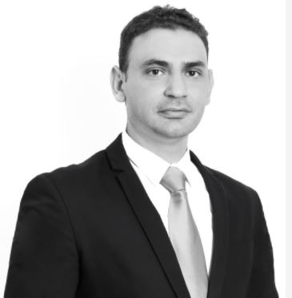

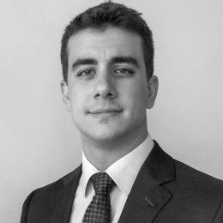
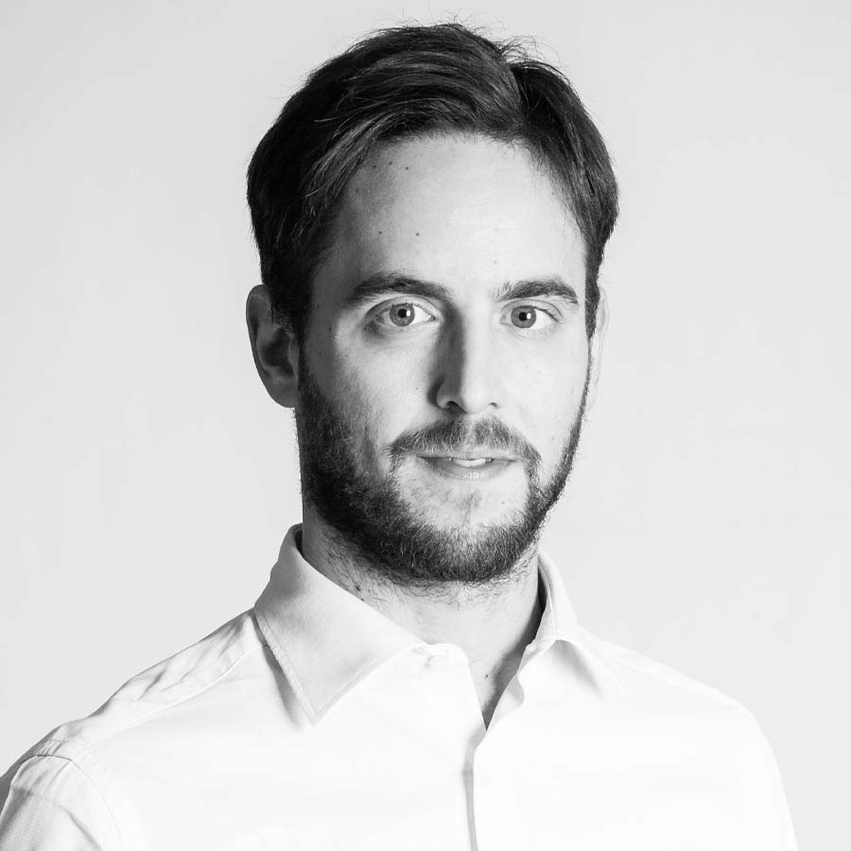
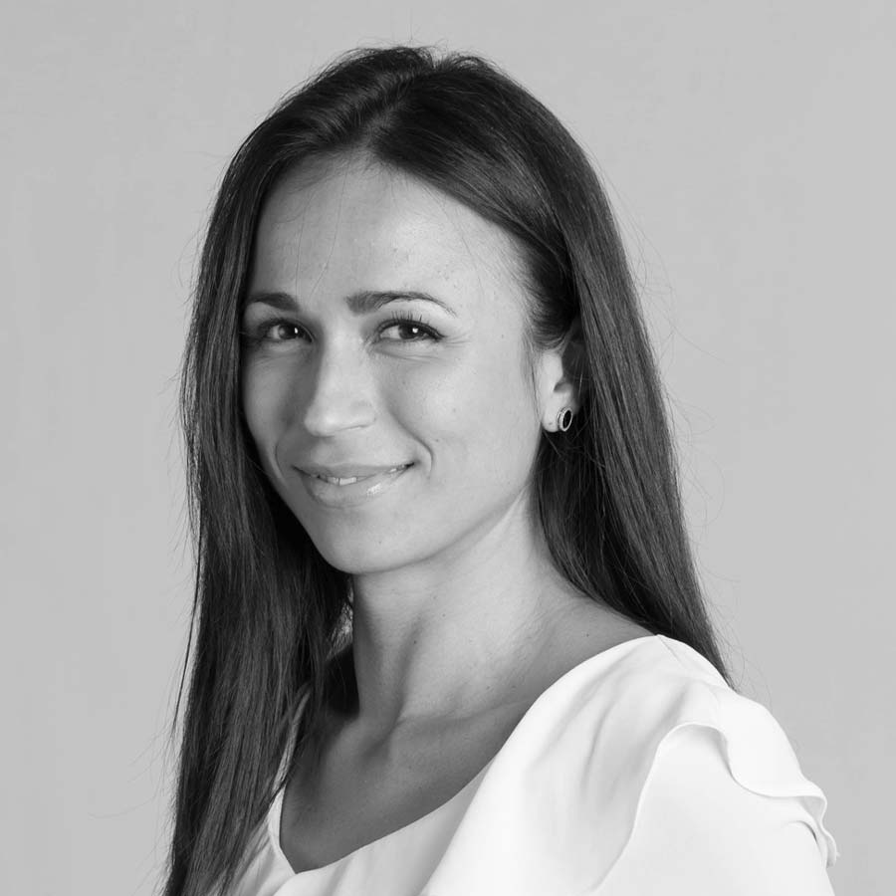

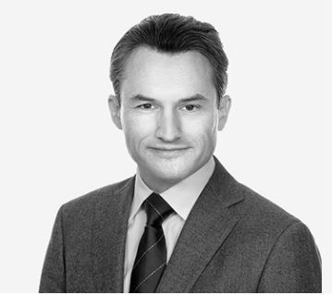
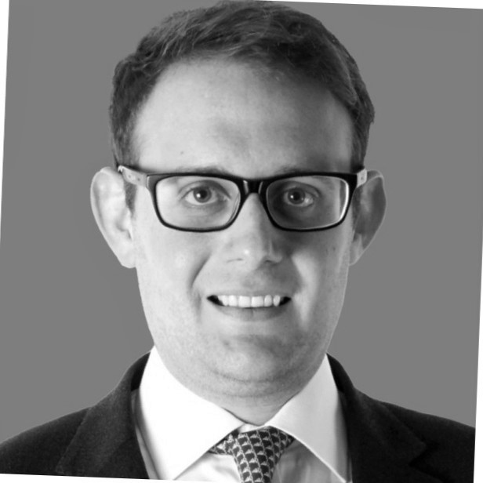
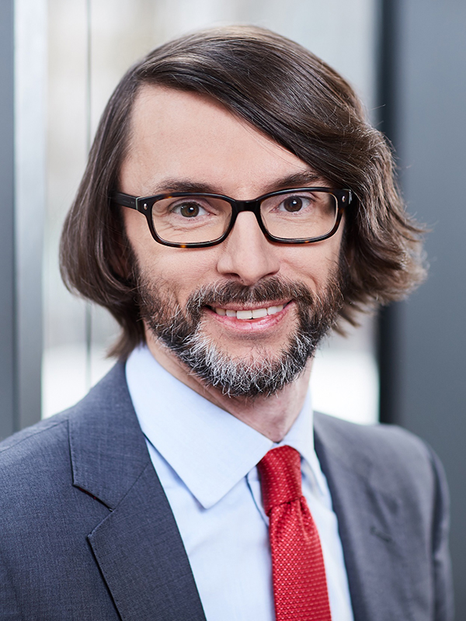
SPEAKERS
Christos A. Theophilou
Costas Savva
Anna Paraskeva
Nikos Maltezos
Luca Galliani
Partner
Partner
Partner
Associate
Manager
Taxand Cyprus
Taxand Cyprus
Zepos & Yannopoulos
Zepos & Yannopoulos
LED Taxand
Cyprus
Cyprus
Greece
Greece
Italy
T: +357 9932 8846
T: +357 9932 8846
T: +30 21 0696 7083
T: +30 210 6967120
T: +39 02 494864
E:ctheophilou@cy.taxand.com
E:csavva@taxand.com.cy
E:a.paraskeva@zeya.com
E: n.maltezos@zeya.com
E: lgalliani@led-taxand.it
Marisana Almeida Dos Santos
Anders Lagerholm
Prof Dr René Matteotti
Jonathan Brecker
Associate
Tax Advisor
Of Counsel
Assistant Director
LED Taxand
Skeppsbron Skatt
Taxpartner
Alvarez & Marsal
Italy
Sweden
Switzerland
UK
T: +39 02 494864
T: +46 4010 7199
T: +41 44 215 77 77
T: +44 207 715 5200
E: madossantos@led-taxand.it
E:anders.lagerholm@skeppsbronskatt.se
E: rene.matteotti@taxpartner.ch
E:jbrecker@alvarezandmarsal.com

Slide 55
ABOUT TAXAND
Taxand is the world’s largest independent tax organisation with more than 550 tax partners and over 2,500 tax advisors in 50 countries. Taxand focuses on delivering high quality, integrated tax advice, free from conflict creating audit work. Taxand advisors work together to deliver global tax services for clients.
www.taxand.com
Taxand is a global organisation of tax advisory firms. Each firm in each country is a separate and independent legal entity responsible for delivering client services.
© Copyright Taxand Economic Interest Grouping 2021 Registered office: 1B Heienhaff, L-1736 Senningerberg – RCS Luxembourg C68
55

