Slide 1
Persuasion skills
TAXAND ASIA SENIOR SCHOOL
27-29 AUG 2018
KUALA LUMPUR
MALAYSIA

Slide 2
UNDERSTANDING PERSUASION
“Few are open to conviction, but the majority of men are open to persuasion”
Johann Wolfgang von Goethe

Slide 3
WHAT IS PERSUASION
Getting the other to agree your point of view

Slide 4
FIVE CORE PERSUASION TASKS
Mapping the influence landscape
Shaping perceptions of interests
Shaping perceptions of alternatives
Gaining acceptance for tough decisions
Persuading at a distance

Slide 5
1. MAPPING THE INFLUENCE LANDSCAPE
Identifying the Key Groups and Subgroups
Analyzing Influence Networks
Identifying Supporters, Opponents, and Persuadable
Assessing Interests
Assessing Alternatives

Slide 6
2. SHAPING PERCEPTIONS OF INTERESTS
Altering Incentives
Framing Decisions
Using Social Influence
Engaging in give some gain some Negotiation
Putting It All Together

Slide 7
3. SHAPING PERCEPTIONS OF ALTERNATIVES
Introducing New Options
Controlling the Agenda
Eliminating “Do Nothing” as an Option
Eliminating the “as is” as an Option
Removing un-necessary Options

Slide 8
4. GAINING ACCEPTANCE FOR TOUGH DECISIONS
Creating a Fair Process
Engaging in Shared Diagnosis
Consulting Broadly
Giving What is Asked For

Slide 9
5. PERSUADING AT A DISTANCE
Developing Reliable Communication Channels
Focus and Repetition
Matching the Medium to the Message
Introducing Powerful Simple lines
Creating a New Mythology
Building Personal Credibility

Slide 10
TACTICS OF PERSUASION
Influencing Tactics
Aversive (unpleasant outcome) Stimulation | Negative Alter casting
Debt | Negative esteem of others
Gifting, Pre-giving | Others Welfare
Liking, Ingratiation (become more likable to others) | Punishment
Moral appeal | Positive Expertise
Negative Expertise | Positive Self – Feeling
Negative Self feeling | Positive Alter Casting
 | Positive esteem of others
 | Reward

Slide 11
TACTICS OF PERSUASION
Defense and resistance tactics
Deflect | Divide
Delay | Debt
Deny | Discredit
Discount | Destroy
Deceive | Deal
 | Be the super best

Slide 12
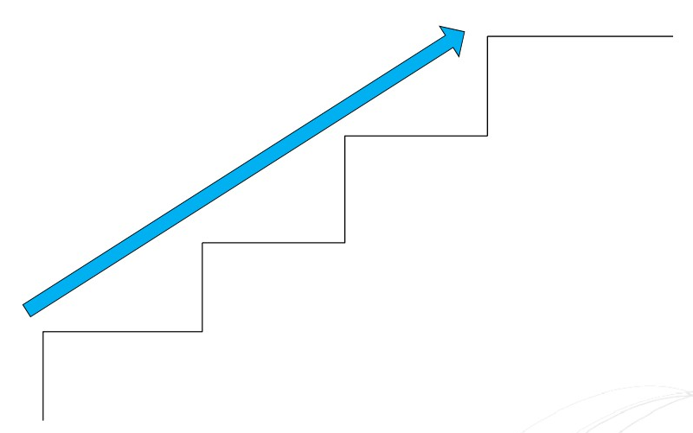
STEPS IN PERSUASION PROCESS
Connect Emotionally
Provide visible evidence
Find common ground
Establish credibility

Slide 13
SIX GOVERNING PRINCIPLES OF PERSUASION
Reciprocity (give in return)
Scarcity (not everything can be achieved or not everything is available)
Authority
Consistency
Consensus (everyone agrees, group decision making process)
Liking

Slide 14
THE FOUR WAYS ONE SHOULDN’T PERSUADE
Don’t attempt an upfront hard sell
Don’t see compromise as surrender
Don’t think that the secret to persuasion lies in presenting great arguments
Don’t assume persuasion is a one-shot effort

Slide 15
THE TECHNIQUES OF PERSUASION
Reason
Using Reason
Resisting Reason
Exchange
Using Exchange
Resisting Exchange
Pressure
Using Pressure
Resisting Pressure

Slide 16
SEVEN LEVERS TO CHANGE PEOPLE’S MINDS
Reason
Research
Resonance (thinking in a similar way)
Representational Re-descriptions (making a point in many different ways)
Resource & rewards
Real World Events
Resistance

Slide 17
ELEVATOR PITCH
Practice, practice, practice
Focus on the impact
Ditch the cultural baggage
Be slow and steady
See the whole world as an elevator

Slide 18
THANK YOU

Slide 19
ABOUT TAXAND
Taxand is the world’s largest independent tax organisation with more than 400 tax partners and over 2,000 tax advisors in over 40 countries. Taxand focuses on delivering high quality, integrated tax advice, free from conflict creating audit work. Taxand advisors work together to deliver global tax services for clients.
www.taxand.com
Taxand is a global organisation of tax advisory firms. Each firm in each country is a separate and independent legal entity responsible for delivering client services.
© Copyright Taxand Economic Interest Grouping 2017 Registered office: 1B Heienhaff, L-1736 Senningerberg – RCS Luxembourg C68

